Slide 1




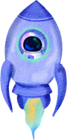







BEYOND
UFO
Jayla, Jeesoo, Ricky

Slide 2











Meet Our Team
Jayla Haskins
Jeesoo Jhun
Ricky Bocek

Slide 3

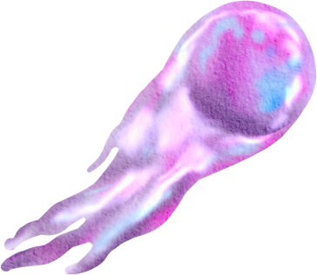


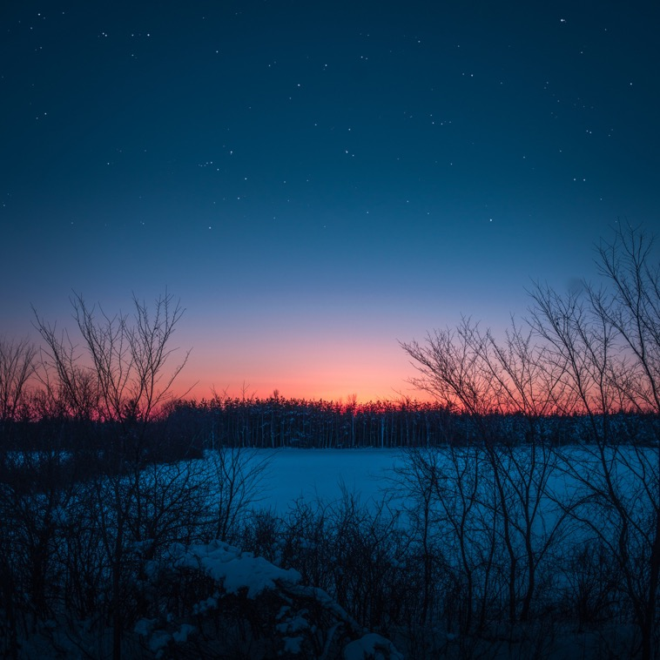


Contents
Overview
Data Understanding & Methods
Analysis & Results
- Regions, Timing, Shapes, Description
Insights & Recommendations
Conclusions

Slide 4
Overview
Objective:
Identify UFO patterns for Tourism, Government, and Research
2. Key Questions:
Where and When are sightings frequent?
Common Shapes and Descriptions?
Time/Season patterns?

Slide 5





Data
Understanding
UFO reports:
- Date, Time, Location, Shape, Duration
2. Key questions:
- Regional frequency, Patterns, Timing Correlations

Slide 6




Methods
1
Descriptive
- Region, time, shape
2
Correlation
- encounter duration vs. time of day
3
Tools
- Heatmaps, bar charts, distribution plots

Slide 7



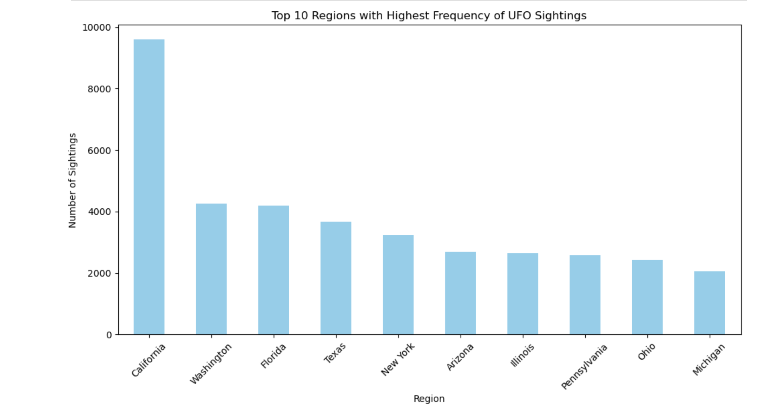



Region
Highest Reports by State
California
Washington
Florida
Texas

Slide 8
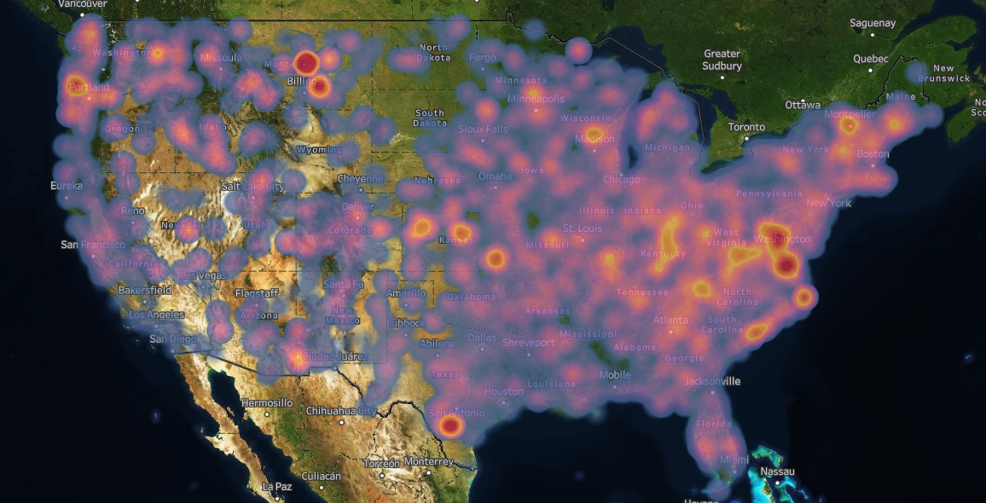
Region
Accounting for Pop.
Current Hot Zones:
Central Montana
DC Area
South Texas

Slide 9
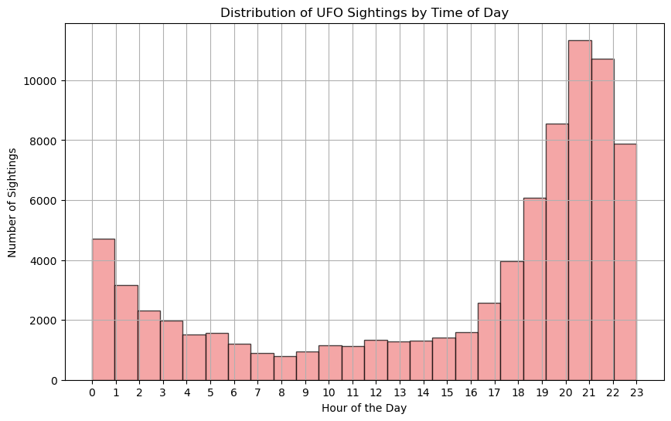
Time
Most encounters occur 20:00-24:00

Slide 10
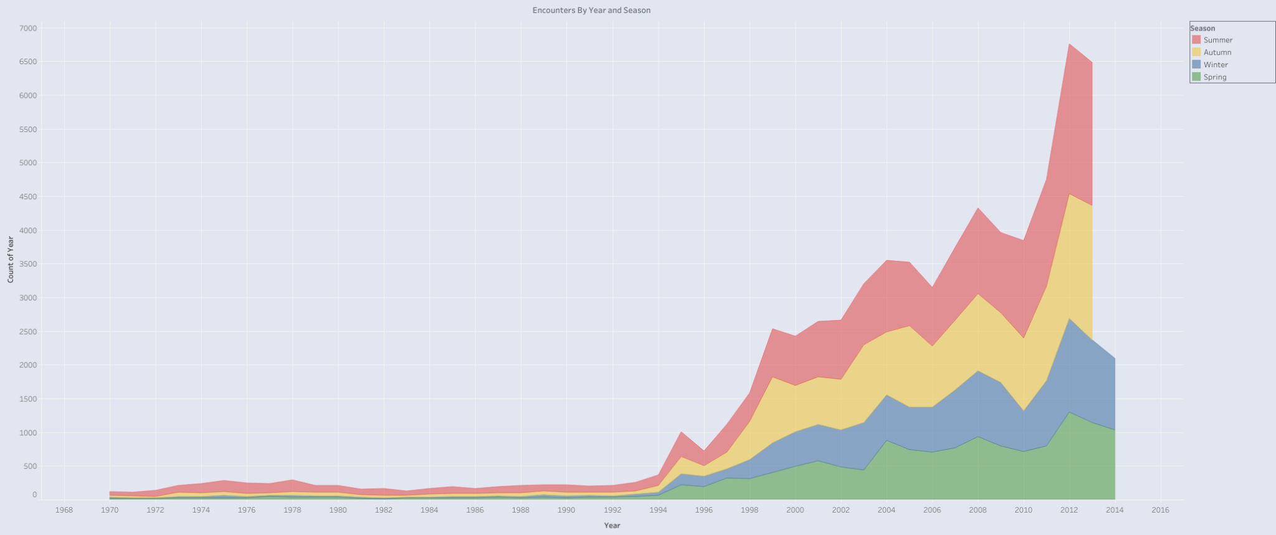
Time
Summer and Autumn are prevalent
Reports Increasing

Slide 11
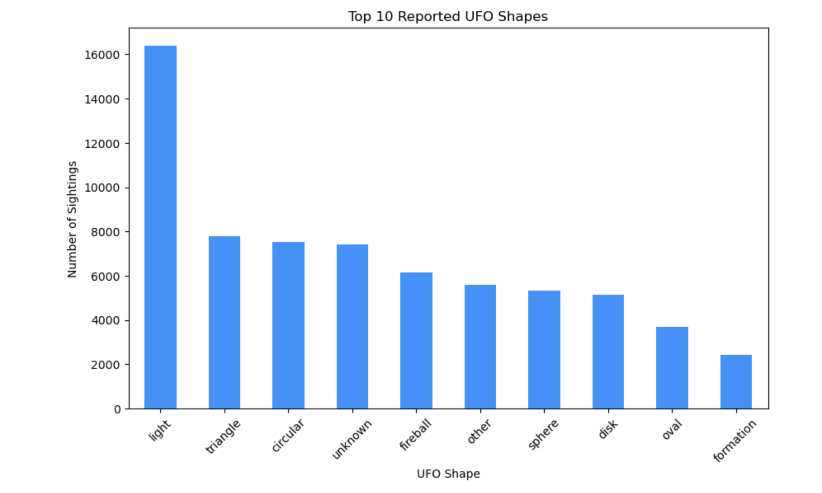
Shape
-Predominantly light
-Many similar shapes!

Slide 12
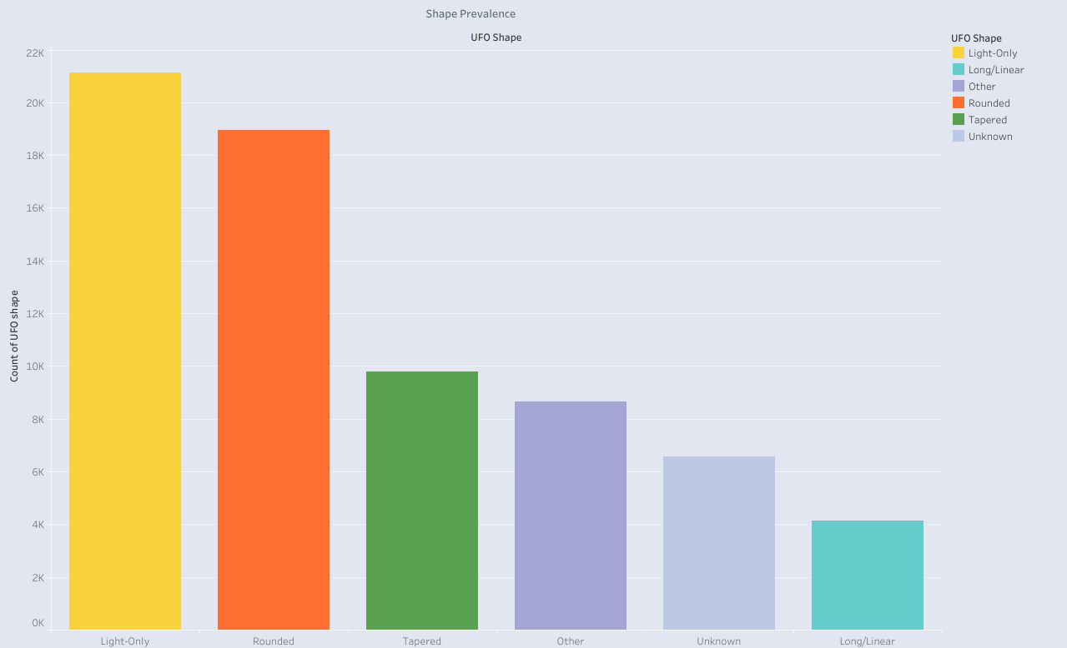
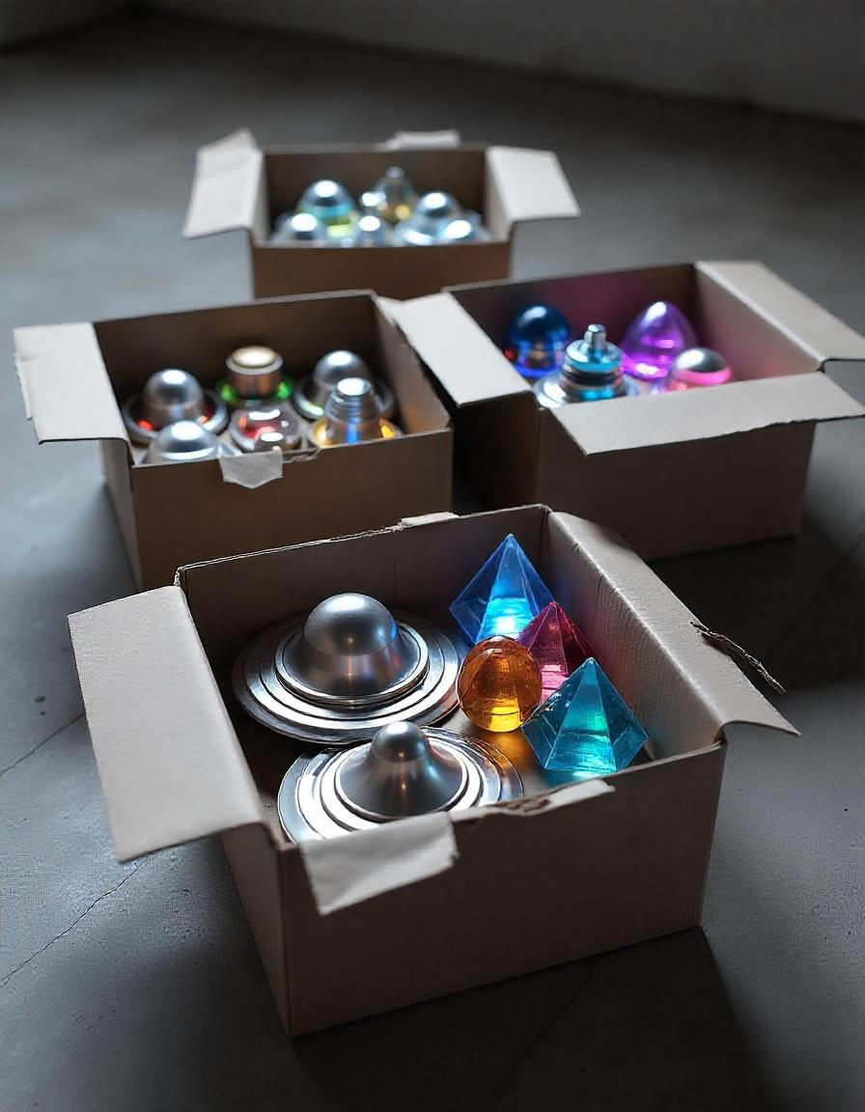
Shape
Sorted Shapes Into Simpler Categories

Slide 13
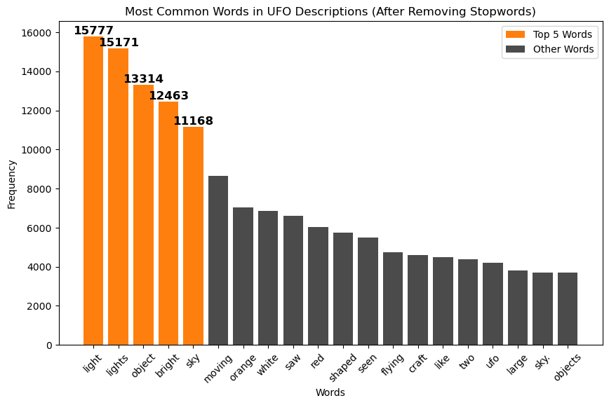
Description
1. “Light”,
2. “Lights”,
3. “Object”,
4. “Bright”,
5. “Sky”
6. “Moving”

Slide 14







Insights
Identifying Key Regions for Tourism
Timing Opportunities for Tour Experiences
Themed Experiences Based on UFO Shapes and Description

Slide 15
Next steps
Demographic
Sentiments
Weather

Slide 16



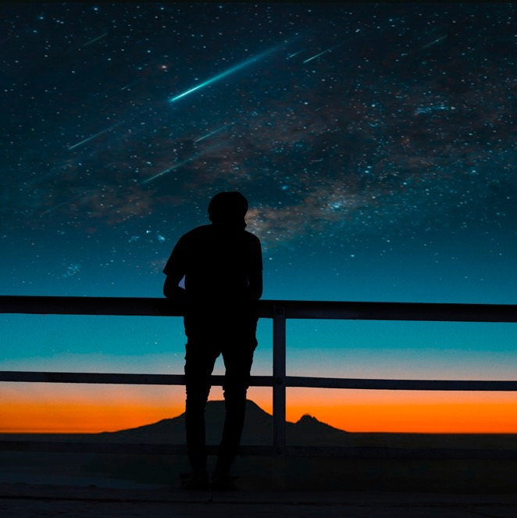

Conclusion
Our findings show how we can capitalize on both the Regions and Timing of UFO sightings to create unforgettable experiences.
Notes:
By focusing on the key areas, the right times of the year, and creating themed activities around what people are most likely to see, we can boost tourism and give visitors a truly out-of-this-world adventure.

Slide 17
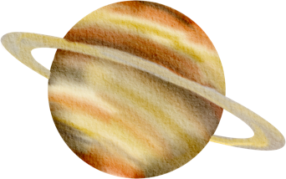









flatiron@flatiron.com
Link to GitHub
Link to Tableu

